Slide 1
Map Skills Test Review
Click on the answer you believe is correct.

Slide 2
What lines run vertically (north to south) and meet at the north and south poles?
Latitude Lines
Longitude Lines
Parallels
Prime Meridian

Slide 3
Sorry, try again.
Click on “?” below.

Slide 4
Correct!
Click on “?” for next question.

Slide 5
What lines run horizontally (east to west) around globe and never touch?
Longitude Lines
Meridians
Latitude Lines
Prime Meridian

Slide 6
Correct!
Click on “?”

Slide 7
Sorry, try again.
Click on “?” to return to question.

Slide 8
These latitude lines are called the Tropics or the Low Latitudes.
Latitudes between 23 ½ north and 23 ½ south.
O degrees latitude
Latitudes between 66 n and the n pole and 66 s and the south pole
Latitudes between 23 ½ n and 66 n.

Slide 9
Sorry, try again.

Slide 10
These lines of latitude are called the Middle Latitudes or the Temperate Zone.
Latitudes between 23 ½ north and 23 ½ south.
O degrees longitude.
Latitudes between 66 n and the n pole and 66 s and the south pole
Latitudes between 23 ½ n and 66 n and between 23 ½ s and 66 s.

Slide 11
Correct! Next question.

Slide 12
Sorry, try again.

Slide 13
Correct! Next question.

Slide 14
0 degree longitude is:
Tropic of Capricorn
Tropic of Cancer
Equator
Prime Meridian
Arctic Circle
Antarctic Circle

Slide 15
Sorry, try again.

Slide 16
23 ½ north latitude is:
Tropic of Capricorn
Tropic of Cancer
Equator
Prime Meridian
Arctic Circle
Antarctic Circle

Slide 17
Correct. Next question.

Slide 18
Sorry, try again.

Slide 19
Correct! Next Question.

Slide 20
66 degrees north is:
Tropic of Capricorn
Tropic of Cancer
Equator
Prime Meridian
Arctic Circle
Antarctic Circle

Slide 21
Correct! Next Question.

Slide 22
Sorry, try again.

Slide 23
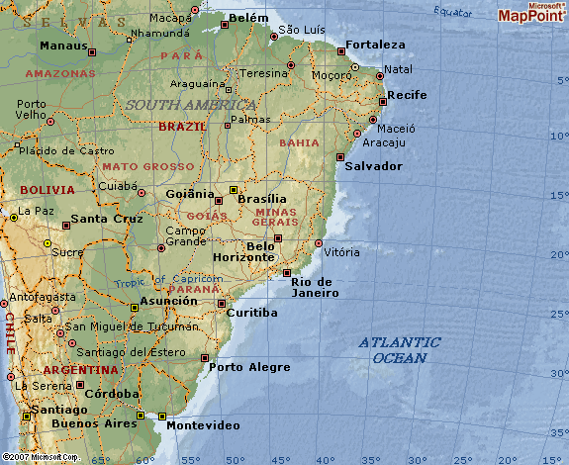
What city is located at:
25 south
50 west
Montevideo Brasilia Curitiba Belem

Slide 24
Sorry, try again.

Slide 25
Correct! Next Question.

Slide 26
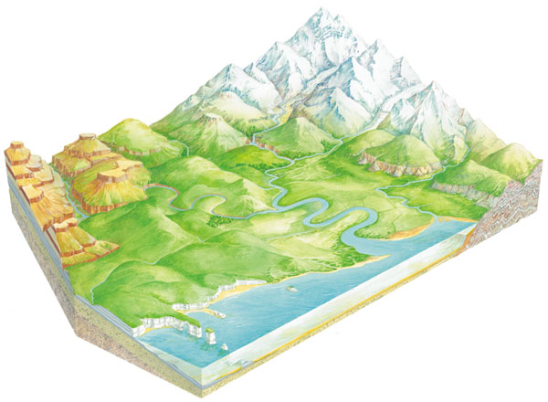
Click on the tributary.

Slide 27
Correct! Try another one!

Slide 28
Click on the peninsula

Slide 29
Sorry, Try again.

Slide 30
Correct! You’re Done!

Slide 31
Sorry, try again.

Slide 32
Sorry, try again.

